Slide 1

Biochemistry (Renal module)
Nucleoprotein metabolism
Shuzan Ali Mohammed
Medical Biochemistry & Molecular Biology
Faculty of Medicine- Benha University
2022

Slide 2
Nucleoprotein metabolism
Diet contains nucleic acids in the form of nucleoproteins
Type: nucleoproteins are conjugated proteins
[non-protein prosthetic group (nucleic acid) attached to one or more molecules of a simple protein]
Simple protein is usually basic protein (histone or protamine)
Nucleoproteins are found in all animals & plants ( in all cell nuclei & protoplasm)

Slide 3
Nucleoprotein metabolism
Nucleoprotein digestion
In the small intestine mainly & to some extent in the stomach)
Nucleoproteins
Pepsin or trypsin
Protein
(protamine & histones)
Nucleic acids (DNA & RNA)
Pancreatic nucleases
Intestinal polypeptidases
Amino acids
Nucleotides
Intestinal nucleotidases
Nucleosides
Phosphate
Intestinal nucleosidases
Purines & pyrimidine bases
Pentose 1-P sugar
(ribose 1- P or deoxyribose 1-P)
Fate of absorbed nucleic acids:
Absorbed purine & pyrimidine: mainly catabolized in the liver
Absorbed nucleosides: may be incorporated in the body nucleic acids

Slide 4
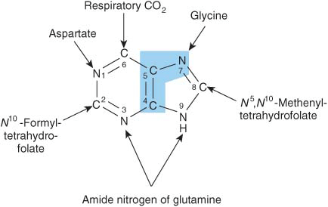
Nucleoprotein metabolism
Purine metabolism
Synthesis of purine nucleotides:
Site: they are synthesized by most tissues, however, the major site is the liver (cytoplasm)
Pathways: major (De novo) and minor (Salvage)
De novo synthesis
The purine ring is formed (de novo) in the body from different metabolic intermediates.
N.B:
Folate is important for formation of C2 & C8 of purine, so folate antagonists (methotrexate) inhibits purine synthesis and cell division so they are used in treating cancers.

Slide 5
De novo purine synthesis

Slide 6
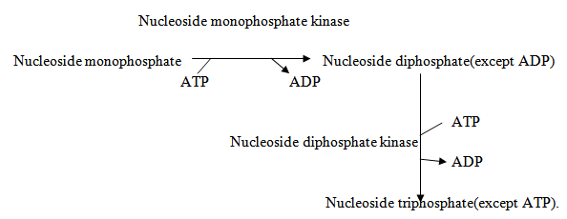
Nucleoprotein metabolism
Synthesis of nucleoside di- and tri-phosphates:
This mechanism is for synthesis of both purine and pyrimidine nucleotide di- and tri-phosphates, which require the corresponding kinase enzyme and ATP.

Slide 7
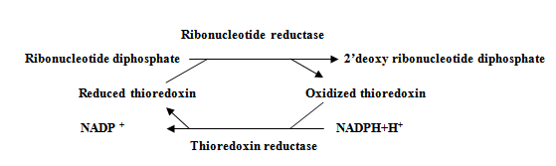
Nucleoprotein metabolism
Synthesis of deoxyribonucleosides:
This applies for synthesis of purine & pyrimidine deoxyribonucleotides. The enzyme ribonucleotide reductase is active only during DNA synthesis

Slide 8
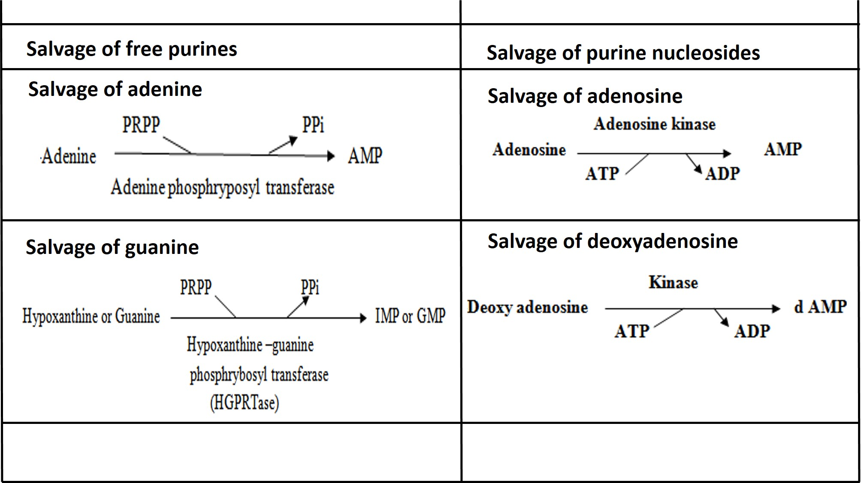
Nucleoprotein metabolism
Purine salvage pathway
Importance: Supply purine nucleotides to certain tissue or cell where the de novo synthesis is not active e.g. brain, red cells and lymphocytes.
(APRTase)

Slide 9
Nucleoprotein metabolism
*Regulation of biosynthesis of purine nucleotides:
Ribose-5-P stimulates PRPP synthetase so ↑ R-5-P as in Von Gierke’s disease (glucose-6-phosphatase deficiency) leading to ↑ de novo synthesis of purines.
Normally, more PRPP is used for purine salvage by HGPRTase than for de novo synthesis, so in Lesch-Nyhan syndrome (HGPRTase deficiency) there is ↑ in de novo synthesis of purines.
High concentration of AMP, ADP, GMP and GDP produce inhibition of conversion of ribose-5-P to IMP at two sites, PRPP synthetase and PRPP-glutamyl amidotransferase.

Slide 10
Nucleoprotein metabolism
*Regulation of biosynthesis of purine nucleotides:
4. Regulation of conversion of IMP to ATP and GTP:
Both AMP & GMP inhibit their own formation by feedback inhibition of adenylosuccinate synthetase & IMP dehydrogenase, respectively.
ATP produces allosteric activation of GMP synthetase that converts XMP to GMP. On the other hand, GTP produces allosteric activation of AS synthetase that converts IMP to AS.

Slide 11
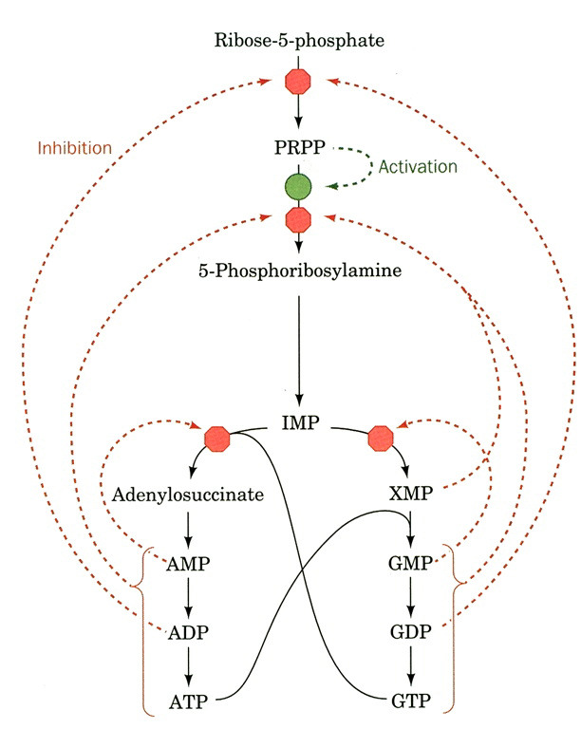
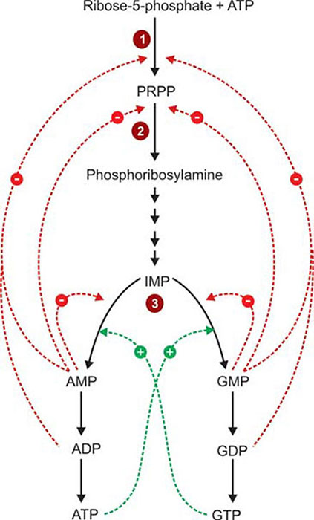
*Regulation of purine nucleotides biosynthesis
Nucleoprotein metabolism

Slide 12
Nucleoprotein metabolism
Analogue of purine synthesis inhibitors:
They act as competitive inhibitors of the naturally occurring nucleotides that are used to synthesize DNA. When wrong bases are incorporated, the DNA becomes functionally inactive. Thereby cell division is arrested. So, they are useful as anticancer drugs. A few examples are:
Mercaptopurine inhibits conversion of IMP to GMP & AMP
Folate antagonists (methotrexate) would affect the reactions involving one carbon group transfer
Azaserine (diazo acetyl-L-serine) is a glutamine antagonist and therefore inhibits reactions involving glutamine.
Other synthetic nucleotide analogues used as anticancer agents are 6-thio guanine and 8-aza guanine.

Slide 13
Nucleoprotein metabolism
Purine catabolism
Uric acid is the end product of purine catabolism in humans. In the tissues:
Nucleic acids are hydrolyzed to nucleosides
Adenosine is catabolized to hypoxanthine
Guanosine is catabolized to xanthine.
In the liver:
Hypoxanthine gives xanthine by xanthine oxidase which is oxidized to uric acid.
Uric acid goes via blood to be excreted by kidneys in urine.
In lower animals (not in humans) uric acid is further oxidized to allantoin by uricase enzyme.
Serum uric acid level:
male: 3-7 mg/dl, female: 2-6 mg/dl
Urinary uric acid level: 0.3 – 0.7 g / d
Uric acid is sparingly soluble in water

Slide 14
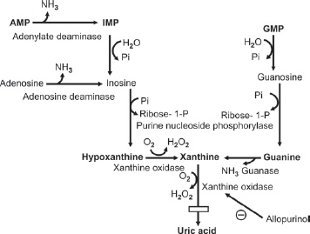
Nucleoprotein metabolism
Purine catabolism
AMP
IMP
Adenosine deaminase
(ADA)
GMP
Phosphomonoesterase
Adenosine
Inosine
Guanosine
Adenosine deaminase
(ADA)
Purine nucleoside phosphorylase
(PNP)
Hypoxanthine
Xanthine
Guanase
Guanine
Xanthine oxidase
Xanthine oxidase
Allopurinol
Uric acid

Slide 15
Nucleoprotein metabolism
Gout
Definition, causes & characters:
Gout is a form of arthritis caused by excess uric acid in the blood stream (hyperuricemia).
Urate crystals accumulate in synovial fluid resulting in inflammation leading to acute arthritis.
At 30ºC, uric acid solubility is lowered, so uric acid is deposited in cooler areas of the body to cause tophi seen in distal joints of foot.
Increased excretion of uric acid (uricosuria) may cause deposition of uric acid cystals in the urinary tract leading to calculi or stone formation with renal damage.

Slide 16
Nucleoprotein metabolism
Types of Gout: 1ry & 2ry
Primary gout: about 1:500 of the total population
About 10% of 1ry gout are idiopathic.
1ry gout may show familial incidence
Causes of 1ry gout:
Abnormal phosphoribosyl amido transferase: The abnormal enzyme is active, but not sensitive to feedback regulation by inhibitory nucleotides →↑ purine synthesis
Abnormal PRPP synthetase (X-linked recessive): not subject to normal allosteric mechanisms →↑ purine synthesis.
Deficient purine salavage pathway enzymes e.g. HGPRTase deficiency (Lesch-Nyhan syndrome): X-linked; 1:10.000 males. ↓ HGPRTase → ↓ salvage →↑ PRPP & ↓ inhibitory purines (self mutilation, mental retardation, ↑ urate & nephrolithiasis. Gout develops later in life. (i.e. brain is dependent on salvage pathway for IMP & GMP needs).

Slide 17
Nucleoprotein metabolism
Causes of 1ry gout (continued):
G-6-Pase deficiency (Von Gierke’s disease or GSD type I): more glucose enters HMP shunt → ↑ ribose-5-P → ↑ PRPP
Glutathione reductase variant: this enzyme depends on NADPH from HMP shunt. The abnormality → ↑ ribose-5-P → ↑ PRPP. Dysregulation of the rate limiting step of purine nucleotide synthesis → ↑ synthesis & degradation of uric acid.

Slide 18
Nucleoprotein metabolism
Secondary gout: causes
↑ production of uric acid: ↑ turnover of nucleic acids as in:
Rapidly growing malignant tissues: leukemia, lymphoma & polycythemia.
↑ tissue breakdown after treatment of large malignant tumors
↑ tissue damage by trauma & ↑ catabolism (starvation)
2. Reduced excretion rate of uric acid:
Renal failure
Treatment with thiazide diuretics (inhibit tubular secretion of uric acid)
Lactic acidosis and ketoacidosis (interference with tubular secretion)

Slide 19
Nucleoprotein metabolism
Treatment policies in gout
Reduce the dietary purine intake
Increase renal excretion by uricosuric drugs, to decrease urate reabsorption from the renal tubules .e.g. probenecid
Reduce urate production by allopurinol, an analogue of hypoxanthine so it is a competitive inhibitor of xanthine oxidase → ↓ urate formation. Xanthine & hypoxanthine are more soluble & easily excreted. Xanthine oxidase converts allopurinol to alloxanthine. (more effective inhibitor of xanthine oxidase (suicide inhibition)
Colchicine; anti-infalammatory very useful to arrest arthritis in gout

Slide 20
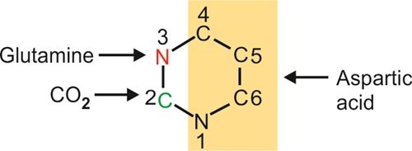
Nucleoprotein metabolism
Pyrimidine metabolism
2 pathways; de novo & salvage
Pathways: major (De novo) and minor (Salvage)
De novo synthesis
The pyrimidine ring (unlike purine) is synthesized as free pyrimidine, then incorporated into nucleotides.
The origin of atoms of pyrimidine nucleus:
Carbamoyl phosphate

Slide 21
Nucleoprotein metabolism
Steps of De novo Pyrimidine synthesis:
Carbamoyl phosphate synthesis: cytoplasmic reaction
It is synthesized from nitrogen of glutamine & bicarbonate by carbamoyl phosphate synthetase II (CPS II).
2. Rate limiting step: Carbamoyl phosphate & aspartate combine to form carbamoyl aspartate by aspartyl transcarbamoylase (ATC), allosteric regulated. C2 & N3 are derived from carbamoyl phosphate & the rest from aspartate.
3. Formation of pyrimidine ring: the 3rd nitrogen & the 4th carbon are joined by a covalent bond. Carbamoyl aspartate is cyclized. Dihydro-orotic acid is produced by dihydro orotase (DHOase)
4. Formation of orotic acid by oxidation: hydrogen atoms are removed so that orotic acid is produced by dihydro orotate dehydrogenase (DHODHase). It requires NAD co-enzyme.

Slide 22
Nucleoprotein metabolism
Steps of De novo Pyrimidine synthesis (continued):
5. Formation of OMP: Ribose-5-P (from PRPP) is added to orotic acid to form orotidylic acid or orotidine monophosphate (OMP) by orotate phosphoribosyl transferase (OPRT ase)
6. Formation of uridine monophosphate (UMP): by OMP decarboxylase (OMPDC). the enzyme is inhibited by 6-aza-uridine (anticancer). UMP is the 1st purine formed.
7. Synthesis of triphosphates: UMP is phosphorylated to UDP with the help of ATP by nucleoside monophosphate kinase (UMP kinase). UDP is phosphorylated to UTP by nucleoside diphosphate kinase (UDP kinase) with ATP help.
8. Formation of CTP from UTP by CTP synthetase (add amino group from glutamine. It needs ATP)

Slide 23
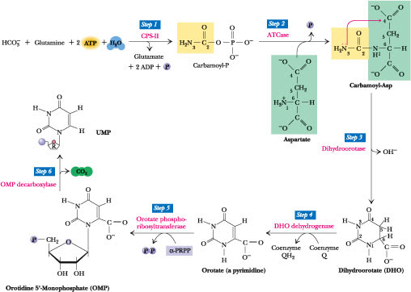
Steps of De novo Pyrimidine synthesis:
Step 1
Step 2
CPS II
ATC
HCO₃⁻ + Glutamine
Carbamoyl-P
Carbamoyl-Aspartate
UMP
Step 3
Dihydro-orotase
H₂O
Step 6
OMP decarboxylase
Step 5
Step 4
Orotate phospho-ribosyl transfrase
DHO dehydrogenase
NADH+H⁺
NAD⁺
Orotate
Dihydo-orotate (DHO)
Orotidine monophosphate (OMP)

Slide 24
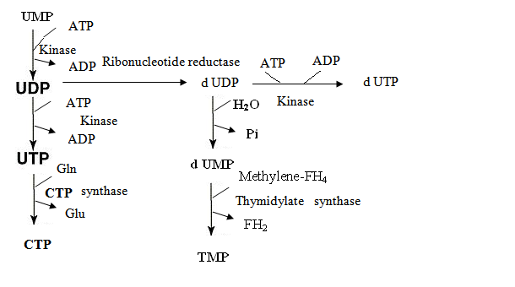
Steps of De novo Pyrimidine synthesis (continued):
Step 7a
Step 7b
Step 8
Synthetase

Slide 25
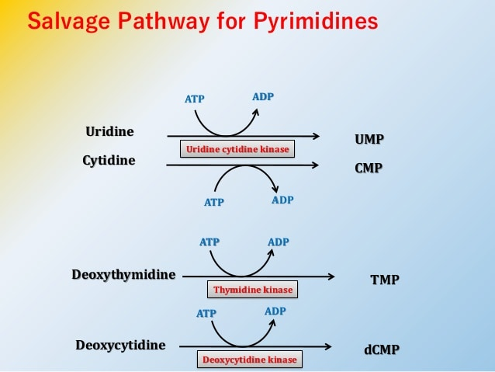
Nucleoprotein metabolism
Pyrimidine salvage pathway
Pyrimidine can also be savaged like purines using PRPP and phosphoribosoyl transferase and nucleoside phosphorylase

Slide 26
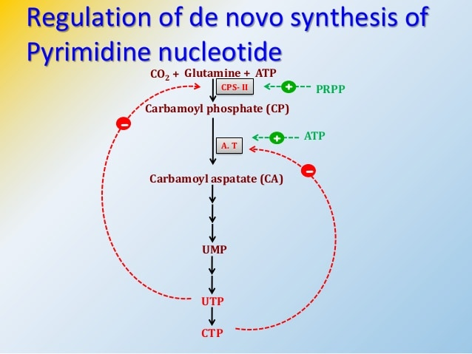
Nucleoprotein metabolism
Regulation of pyrimidine synthesis:
The major regulatory step in prokaryotes is the reaction catalyzed by aspartate transcarbamoylase (ATC) which is allosterically inhibited by CTP.
In the mammalian cells, the regulation occurs at the level of CPS II which is inhibited by UTP and activated by PRPP. Aspartate transcarbamoylase is inhibited by CTP and is activated by ATP.
Further, OMP decarboxylase is inhibited by UMP
CPS II
ATC

Slide 27
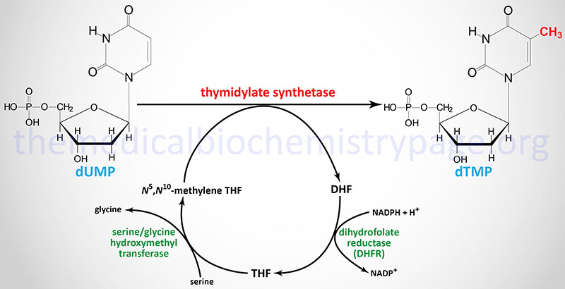
Nucleoprotein metabolism
Synthesis of deoxythymine nucleotides:
The thymine nucleotide is formed by thymidylate synthetase by methylation of dUMP.
The methyl group is denoted by N5, N10 – methylene – THFA. Later THFA is regenerated by dihydrofolate reductase using NADPH as the reductant.
Thymidylate synthase
(Methylene donor)

Slide 28
Nucleoprotein metabolism
Anticancer agents acting on pyrimidines:
Methotrexate inhibits the enzyme dihydrofolate reductase → ↓ the regeneration of THFA → -- dTMP synthesis → -- DNA
(methotrexate is a powerful anticancer agent)
5-fluoro-uracil, 5-iodo uracil, 3-deoxy uridine, 6 aza uridine, 6-aza cytidine and 5-iodo-2-deoxyuridine are anticancer drugs, which competitively inhibit thymidylate synthase. Cytosine arabinoside where ribose is replaced by arabinose is another anticancer agent.

Slide 29
Nucleoprotein metabolism
Orotic aciduria
It results from absence of one or both enzymes; OPRT ase and OMP decarboxylase → ↑ orotic acid production → ↑ excretion of urine
It is autosomal recessive, with retarded growth & megaloblastic anemia. The rapidly growing cells are more affected (anemia). Crystals are excreted in urine which may cause urinary tract obstruction.
Due to lack of feedback inhibition, orotic acid production is excessive
It can be successfully treated by feeding cytidine or uridine. They may be converted to UTP which can act as feedback inhibitor
Orotic aciduria may also occur in ornithine transcarbamoylase deficiency (urea cycle enzyme) as carbamoyl phosphate accumulates due to defective conversion to citrulline. Allopurinol compete with orotic acid for the enzyme orotate phosphoribosoyl transferase, leading to orotic aciduria & orotidinuria.

Slide 30
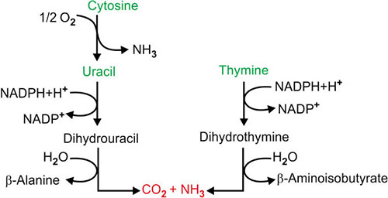

Nucleoprotein metabolism
Catabolism of pyrimidine nucleotides:
Uracil & thymine are degraded by analogous reactions. The phosphate is removed from nucleotide → corresponding nucleoside
In the next step, free base is released, the ring is open
Finally, ꞵ amino isobutyric acid or ꞵ alanine are formed.
These are the end product of pyrimidines. Other products are carbon dioxide and ammonia. Pseudouridine is not metabolized further, and is excreted as such in urine.
Cytosine
Uracil
Thymine
CO-ASH
Methylmalonyl CoA
Succinyl CoA

